Slide 1
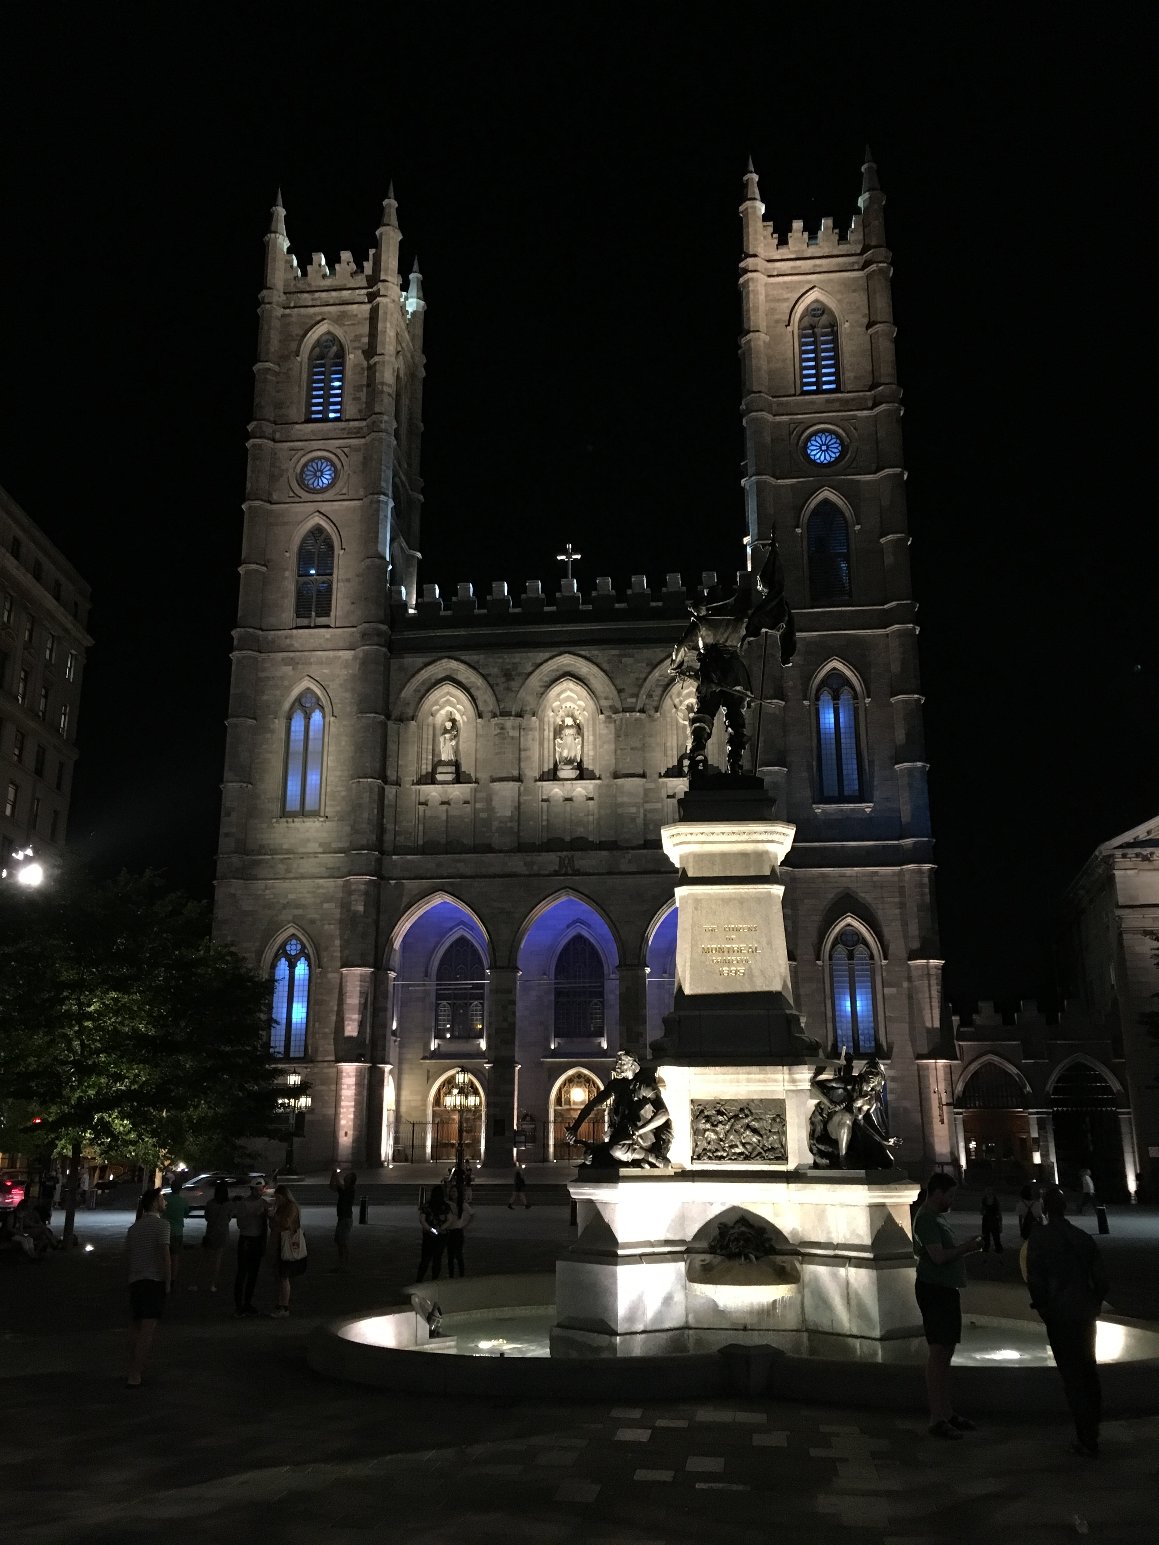
IETF Hackathon
IETF 102
14-15 July, 2018
Montreal

Slide 2
Welcome
First IETF event?
First IETF Hackathon?
Not attending IETF meeting?

Slide 3
Why Are We Here
Advance pace and relevance of IETF standards
Bring speed and collaborative spirit of open source software into the IETF
Flush out ideas, feed into WG session
Produce sample code/reference implementations, utilities
Attract developers, young people to IETF
Match young, skillful developers with IETF veterans
University engagement around hackathon projects

Slide 4
Note Well
This is a reminder of IETF policies in effect on various topics such as patents or code of conduct. It is only meant to point you in the right direction. Exceptions may apply. The IETF's patent policy and the definition of an IETF "contribution" and "participation" are set forth in BCP 79; please read it carefully.
As a reminder:
By participating in the IETF, you agree to follow IETF processes and policies.
If you are aware that any IETF contribution is covered by patents or patent applications that are owned or controlled by you or your sponsor, you must disclose that fact, or not participate in the discussion.
As a participant in or attendee to any IETF activity you acknowledge that written, audio, video, and photographic records of meetings may be made public.
Personal information that you provide to IETF will be handled in accordance with the IETF Privacy Statement.
As a participant or attendee, you agree to work respectfully with other participants; please contact the ombudsteam (https://www.ietf.org/contact/ombudsteam/) if you have questions or concerns about this.
Definitive information is in the documents listed below and other IETF BCPs. For advice, please talk to WG chairs or ADs:
BCP 9 (Internet Standards Process)
BCP 25 (Working Group processes)
BCP 25 (Anti-Harassment Procedures)
BCP 54 (Code of Conduct)
BCP 78 (Copyright)
BCP 79 (Patents, Participation)
https://www.ietf.org/privacy-policy/ (Privacy Policy)

Slide 5
IPR and Code Contribution Guideline
Hackathon participants free to work on any code
Rules regarding that code are what each participant's organization and/or open source project says they are
The code itself is NOT an IETF contribution
Discussions, presentations, and demos done as part of the hackathon are the same type of IETF contributions as those made in working groups; therefore, the usual IETF copyright and/or IPR disclosure rules apply

Slide 6
Agenda - Saturday
08:30: Room open for setup by project champions
09:00: Room open for all - Pastries and coffee provided
09:30: Hackathon kickoff ​Join via Meetecho
09:45: Form Teams
12:30: Lunch provided
15:30: Afternoon break - Snacks provided
19:00: Dinner provided
22:00: Room closes, door are locked

Slide 7
Agenda - Sunday
08:30: Room opens - Pastries and coffee provided
12:30: Lunch provided
13:30: Hacking stops, prepare brief presentation of project
14:00: Project presentations to other participants ​Join via Meetecho
15:45: Closing remarks and opportunities for next time
16:00: Hackathon ends
17:00: Tear down complete

Slide 8
Project List
QUIC
LPWAN CoAP/UDP/IPv6 SCHC compression and fragmentation
DNSSD extensions for multi-link networks
DNS/DNSSEC/DNS Privacy
YANG/NETCONF/RESTCONF
MEF EVC Service YANG Models in Unimgr Project of ODL
RIFT LIEs
Network Time Security (NTS)
JSON Meta Application Protocol (JMAP)
Security Automation and Continuous Monitoring (SACM)
Control Plane and User Plane Separation BNG control channel Protocol (CUSP)
Authentication and Authorization for Constrained Environments (ACE)
WISHI (Work on IoT Semantic / Hypermedia Interoperability)
Limited Usage of Remote Keys (LURK)
TLS 1.3
Software Update for IoT (SUIT)
HTTP error code 451
Human Rights Review Team
MLS implementations
DOTS Interop
Interface to Network Security Functions (I2NSF) Framework
Scalable, Privacy-preserving In-Network (SPIN Bit) Measurement
YANG/CoMI
NETVC
PERC

Slide 9
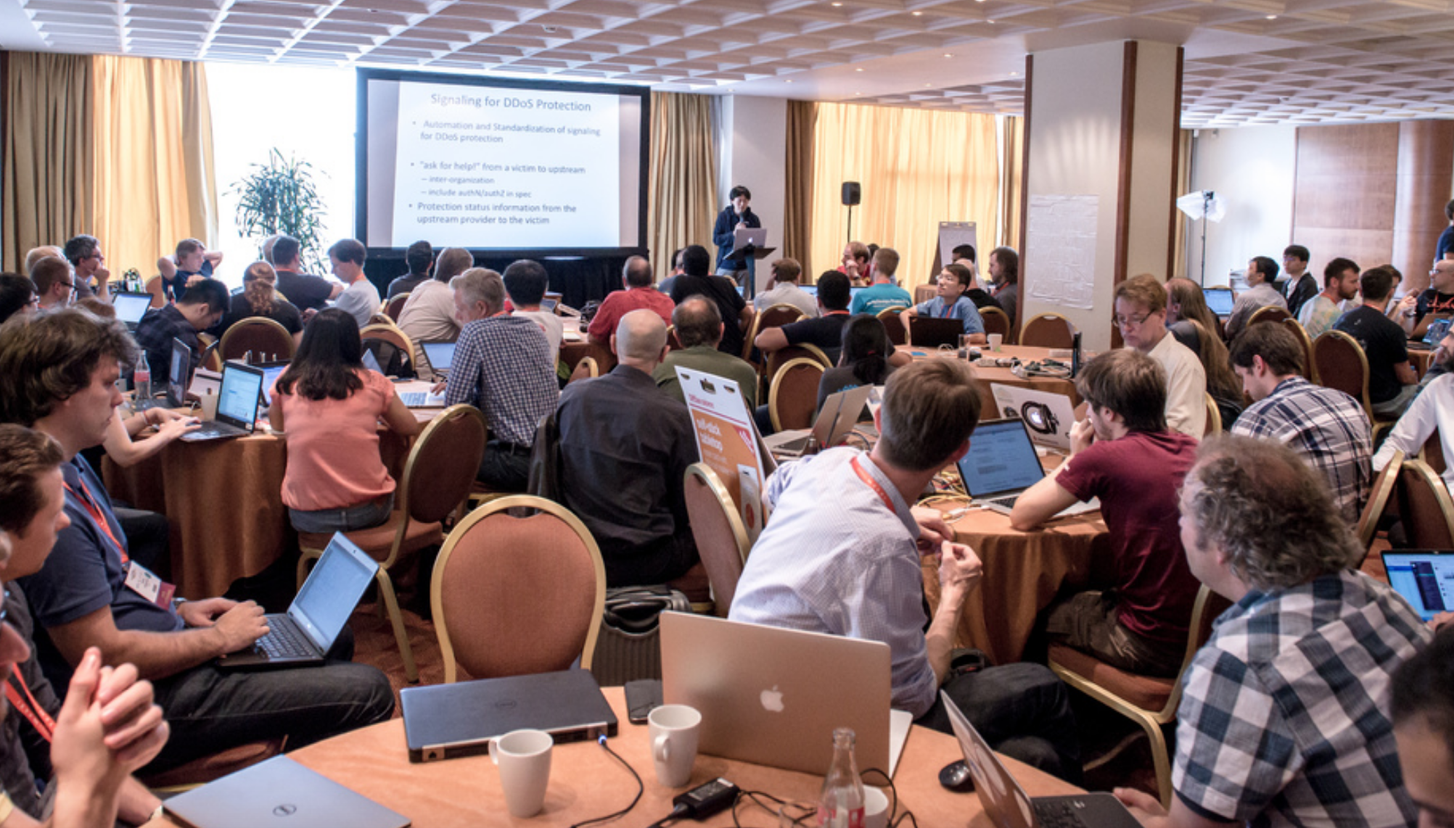
Project Presentations
What problem you tried to solve?
What you achieved?
Highlights
Lessons learned
Feedback to work group
First time IETFers
Open source, other SDOs
3 minute time limit

Slide 10
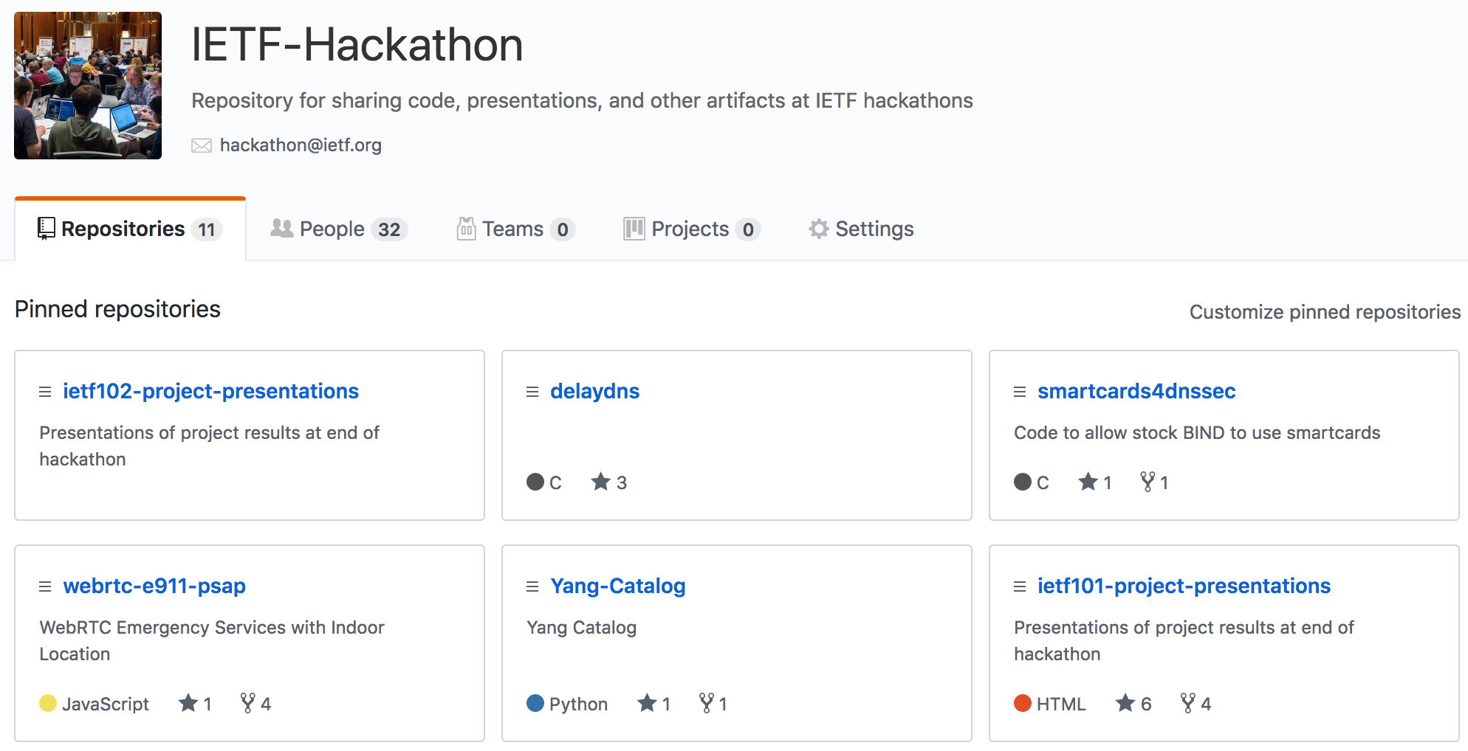
https://github.com/ietf-hackathon

Slide 11
https://github.com/ietf-hackathon

Slide 12
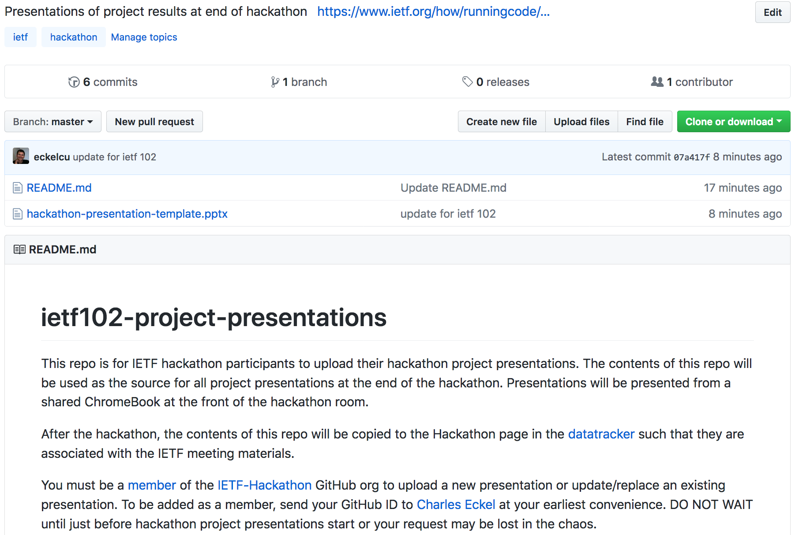
https://github.com/IETF-Hackathon/ietf102-project-presentations

Slide 13
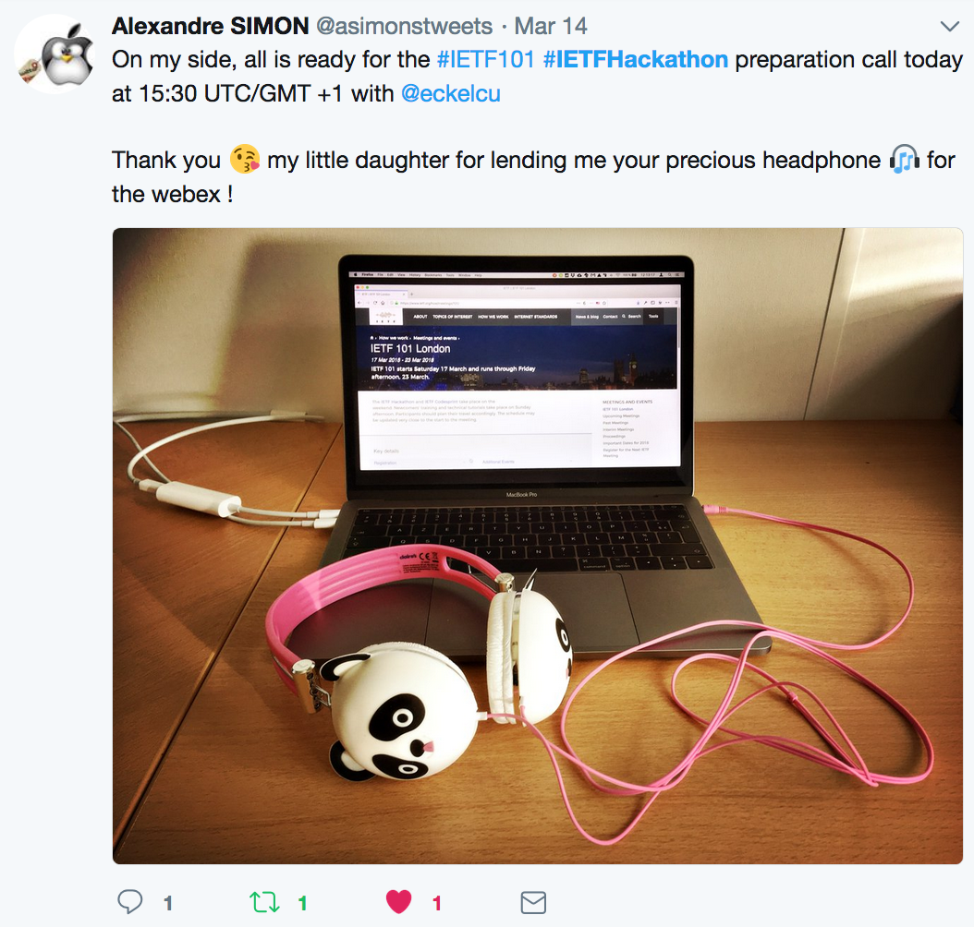
Spread the News
Post to Twitter
#IETFHackathon
#IETF102

Slide 14
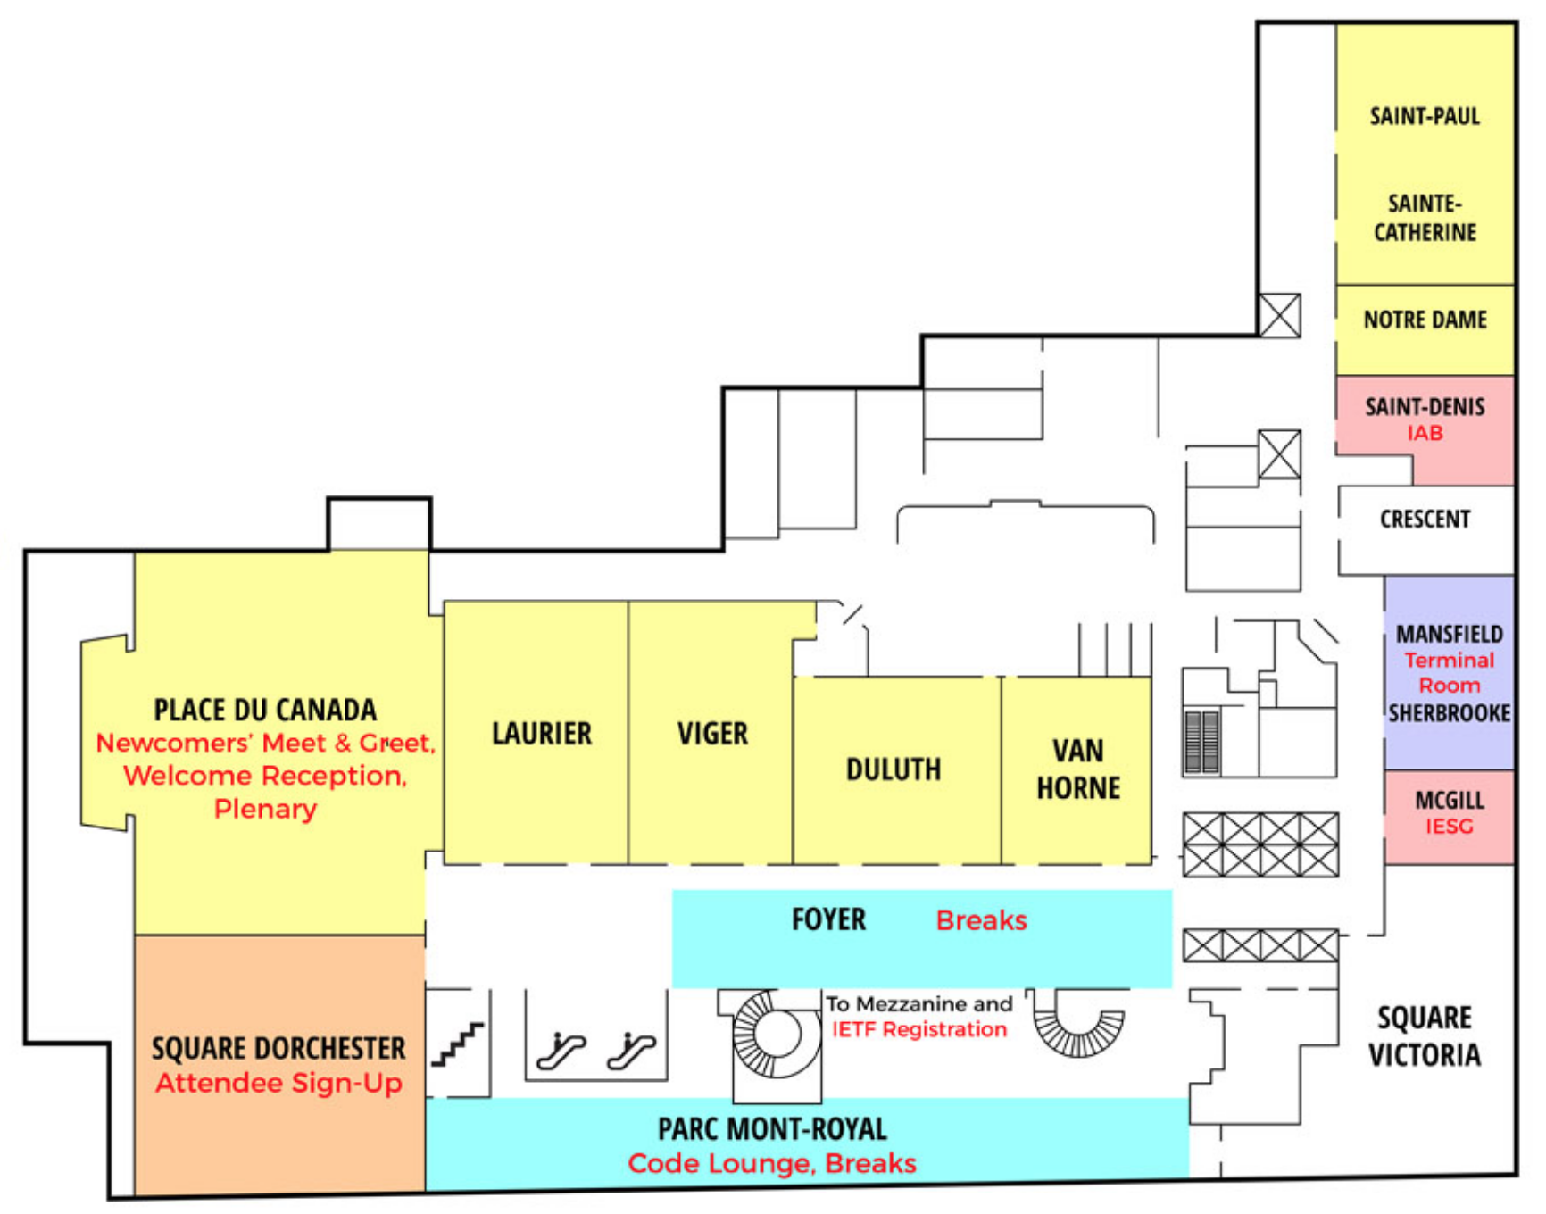
Code Lounge 2nd Floor / Convention Floor (2)
Space reserved in lounge all week
Collaborate on running code
Schedule time for your team

Slide 15
Hackdemo Happy Hour 2nd Floor / Convention Floor (2)
Share hackathon projects with IETF Community
Monday 1750-2010
Code Lounge
Register for space for your team
MUST REGISTER BY 1200 MONDAY

Slide 16



THANK YOU!

Slide 17

Questions?

Slide 18
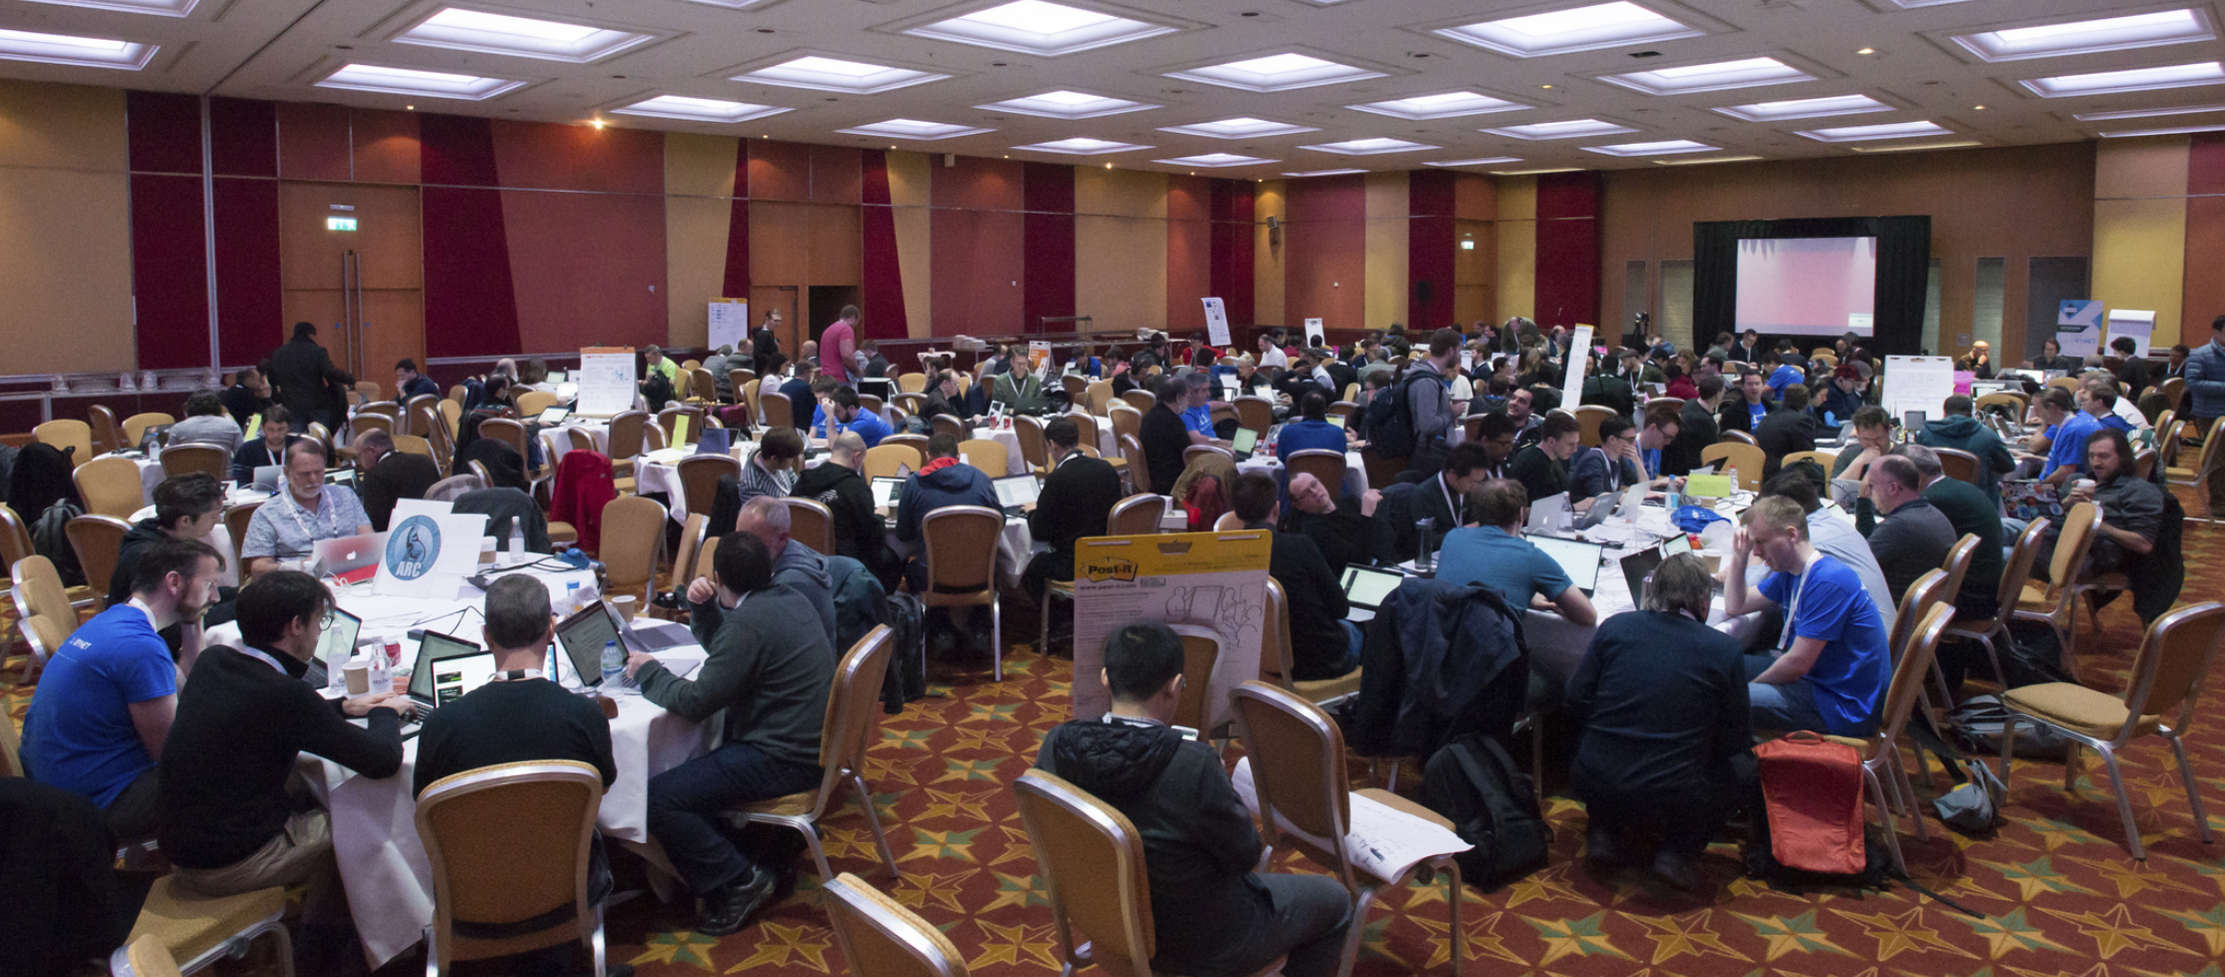
Let’s Start Hacking!

